Slide 1
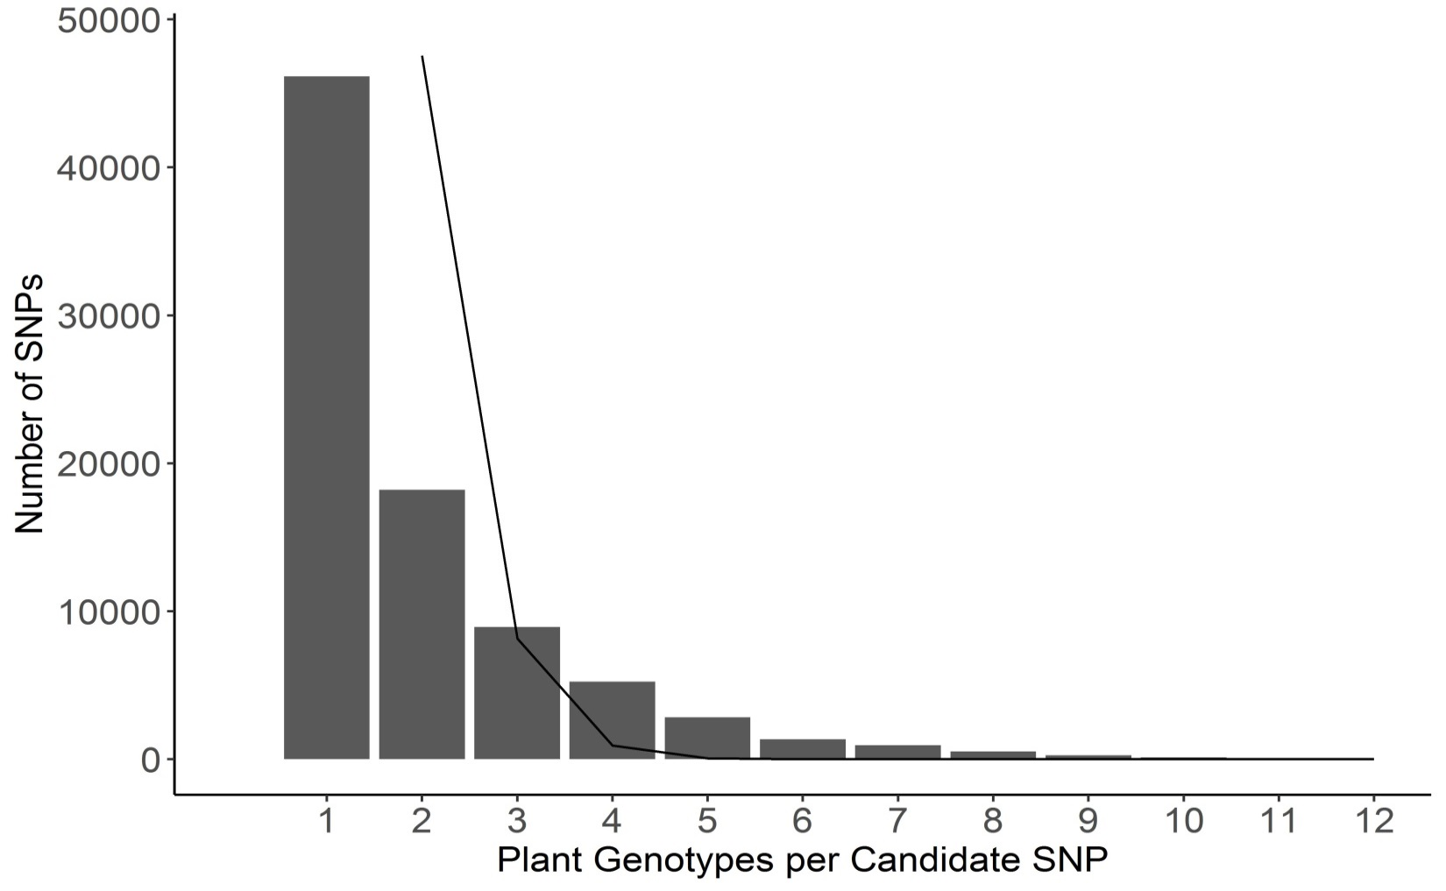
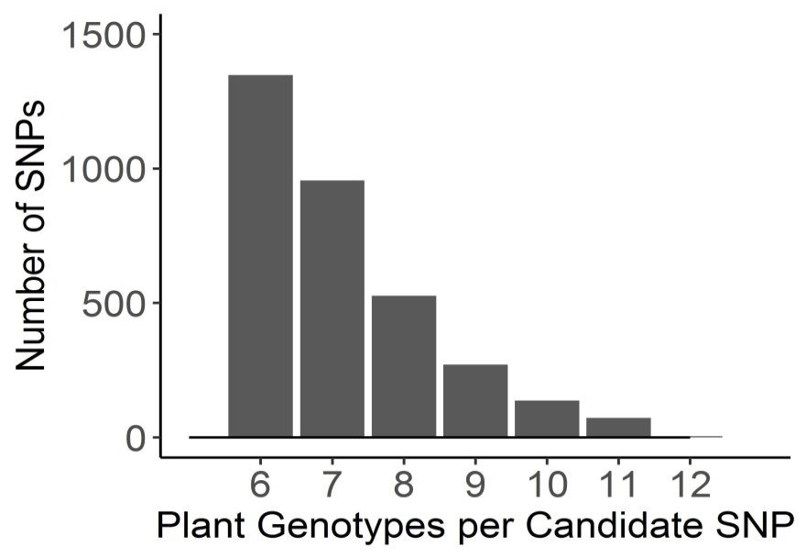
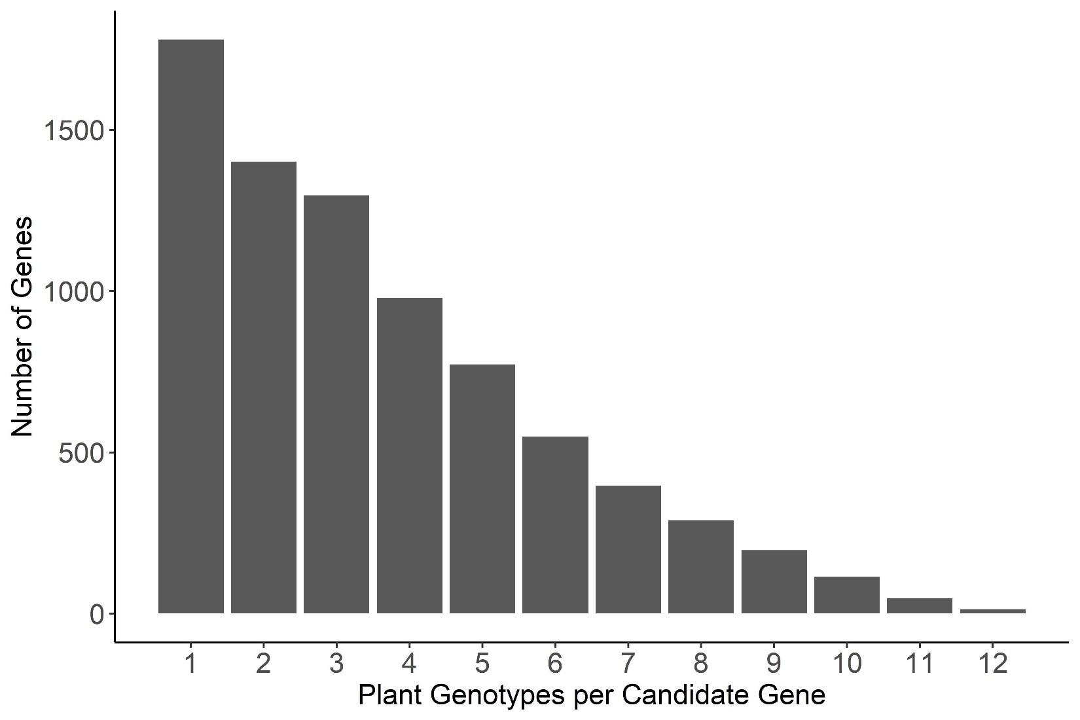
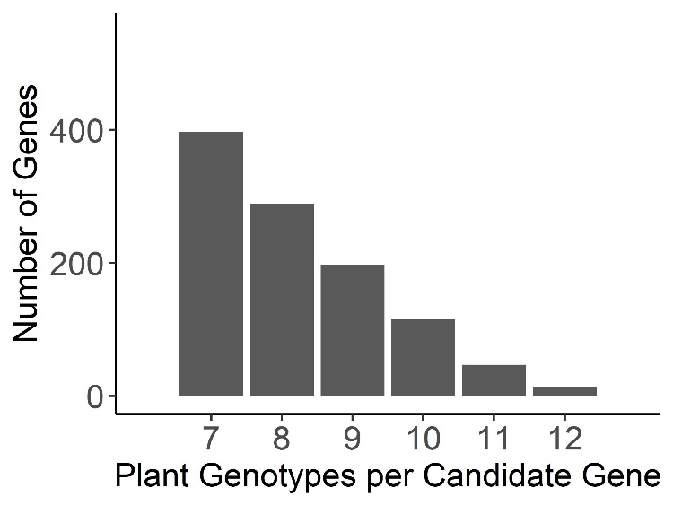
a
b
Notes:
Figure 5.

Slide 2
Figure 5. Frequency of overlap in B. cinerea GWA significance across tomato accessions.
a) The frequency with which the B. cinerea SNPs significantly associate with lesion size on the 12 tomato accessions using bigRR and the 99% permutation threshold. The black line indicates the expected frequency of random overlap, given the number of significant SNPs per plant genotype and size of total SNP set. The inset zooms in on the distribution for overlapping SNPs above 6 plant genotypes for easier visualization. There were no SNPs expected to overlap by random chance in the inset.
b) The frequency with which B. cinerea genes significantly associated with lesion size on the 12 tomato accessions. Genes were called as significant if there was one significant SNP called at the 99% permutation threshold within the gene body, or within 2kb of the gene body.

